Slide 1


<Name>
<Date>

Slide 2

Outline
Executive Summary
Introduction
Methodology
Results
Conclusion
Appendix

Slide 3
Executive Summary
Summary of methodologies
Data Collection through API
Data Collection with Web Scraping
Data Wrangling (Data Cleaning)
Exploratory Data Analysis with SQL
Exploratory Data Analysis with Data Visualization
Interactive Visual Analytics with Dash and Folium
Machine Learning Prediction
Summary of all results
Exploratory Data Analysis result
Interactive Analyctis
Predictive Analystics result

Slide 4
Introduction
Project background and context:
We will predict if the Falcon 9 first stage will land successfully. SpaceX advertises Falcon 9 rocket launches on its website with a cost of 62 million dollars; other providers cost upward of 165 million dollars each, much of the savings is because SpaceX can reuse the first stage
Problems you want to find answers:
If we can determinate if the first stage will land, we can determinate the cost of a launch.

Slide 5

Section 1

Slide 6
Methodology
Executive Summary
Data collection methodology:
Request to the SpaceX API and Web Scraping
Perform data wrangling
Data cleaning
Perform exploratory data analysis (EDA) using visualization and SQL
Perform interactive visual analytics using Folium and Plotly Dash
Perform predictive analysis using classification models
How to build, tune, evaluate classification models

Slide 7
Data Collection
Request to the SpaceX API
Historical Launch records from Wikipedia
Create a dataframe from it
Describe how data sets were collected:
From: https://api.spacexdata.com/v4/rockets/
From https://en.wikipedia.org/wiki/List_of_Falcon_9_and_Falcon_Heavy_launches

Slide 8
Data Collection – SpaceX API
Space X have a API from where data can be obtained.
Source Code: https://github.com/IlkaQ02/Cursos/blob/main/Week%201%20-%202.jupyter-labs-webscraping.ipynb
Request API
Filter data the "Falcon 9" launches
Clean the missing values.

Slide 9
Data Collection - Scraping
Request the Falcon9 form URL.
Create BeatifulSoup object from HTML response.
Source Code: https://github.com/IlkaQ02/Cursos/blob/main/Week%201%20-%202.jupyter-labs-webscraping.ipynb
Request the Falcon9 Launch Wiki page "BeatifulSoup"
Extract all column names from the HTML table header
Create a date frame

Slide 10
Data Wrangling
Perform exploratory Data Analysis and determine Training Labels
Source Code:
https://github.com/IlkaQ02/Cursos/blob/main/Week%201%20-%203.labs-jupyter-spacex-Data%20wrangling.ipynb
Exploratory Data Analysis
Summary
Create a landing outcome label outcome column

Slide 11
EDA with SQL
SQL queries to solve the assignment tasks, to find out for instance:
Names of unique launch sites.
Total payload mass carried by boosters
The average payload mass carried by booster version F9 V1.1
Number of successful and failure missin outcomes
Failed landing outcomes in drone ship, booster and launch site names.
Code Source: https://github.com/IlkaQ02/Cursos/blob/main/Week%202%20-%201.jupyter-labs-eda-sql-coursera_sqllite.ipynb

Slide 12
EDA with Data Visualization
Exploratoring and Preparing Data
Scatter plot FlightNumber vs PayloadMass
Scatter plot FlightNumer vs Launch Site
Scatter plot Pay Load Mass (kg) vs Launch Site
Bar Chart Orbit vs Class
Scatter Flight Number vs Orbit
Scatter plot Payload vs Orbit
Code Source: https://github.com/IlkaQ02/Cursos/blob/main/Week%202.%202.edadataviz.ipynb

Slide 13
Build an Interactive Map with Folium
Summarize what map objects such as markers, circles, lines, etc. you created and added to a folium map
Markers indicate points like launch sites
Circles indicate areas for specific coordinates
Markers clusters are groups of events
Linea are the distance between two coordinates.
Code Source: https://github.com/IlkaQ02/Cursos/blob/main/Week%203%20-%201.lab_jupyter_launch_site_location.ipynb

Slide 14
Build a Dashboard with Plotly Dash
Create interactive dashboard with Plotly Dash
Plot pie charts with the total launches by site
Scatter graph "Outcome and Payload Mass (KG) for each booster version
Code Source: https://github.com/IlkaQ02/Cursos/blob/main/Week%203%20-%203.spacex_dash_app.py

Slide 15
Predictive Analysis (Classification)
Load the dataframe
Create a Numpy array form the column Class
Standardize the data
Split the data set in training and test data
Apply algorithms and check hyperparameters.
Calculate the accuracy for each algorithms
Select the best algorithms. The more importante is select the model with more interpretability
Code Source: https://github.com/IlkaQ02/Cursos/blob/main/Week%204%20-%20SpaceX_Machine%20Learning%20Prediction_Part_5.ipynb

Slide 16
Results
Exploratory data analysis results
Interactive analytics demo in screenshots
Predictive analysis results

Slide 17

Section 2

Slide 18
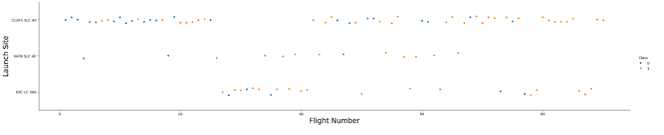
Flight Number vs. Launch Site
CCAFS SLC 40 is the more used Launch Site.

Slide 19
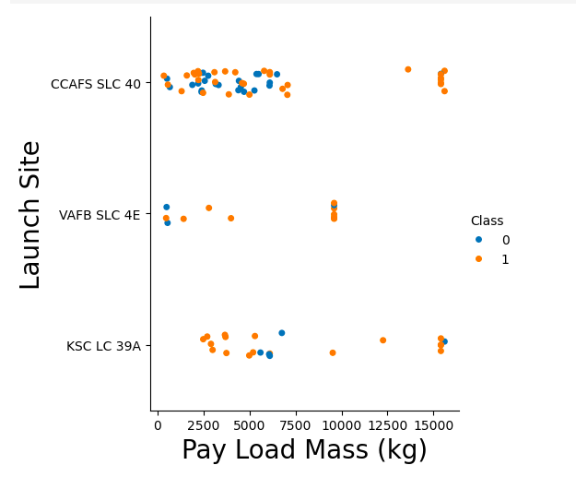
Payload vs. Launch Site
Launches with heavier payloads have more success, and the success rate at CCAFS SLC 40 with heavier payloads is 100%.

Slide 20
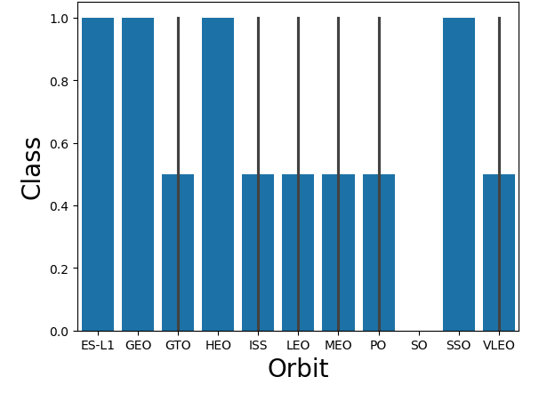
Success Rate vs. Orbit Type
ES-L1, GEO, HEO and SSD had the most success rate.

Slide 21
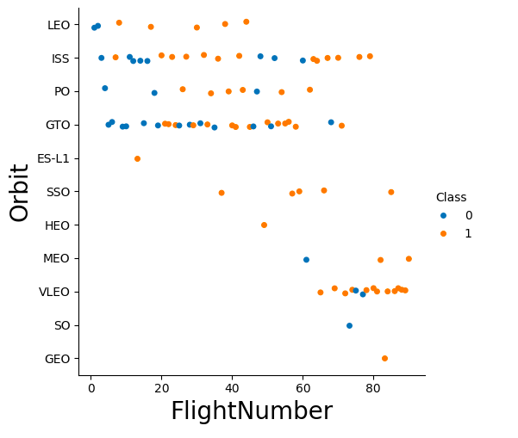
Flight Number vs. Orbit Type
Show the screenshot of the scatter plot with explanations

Slide 22
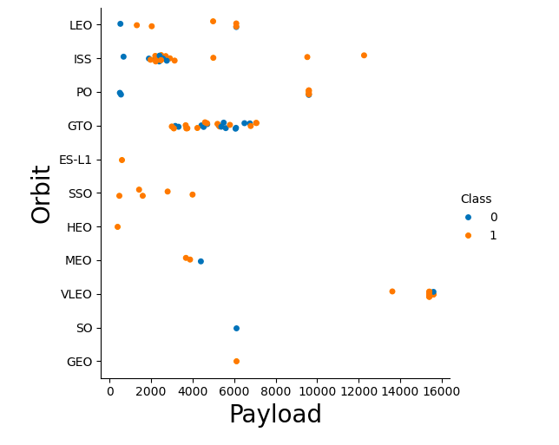
Payload vs. Orbit Type
With heavy payloads the successful landing or positive landing rate are more for Polar,LEO and ISS.

Slide 23
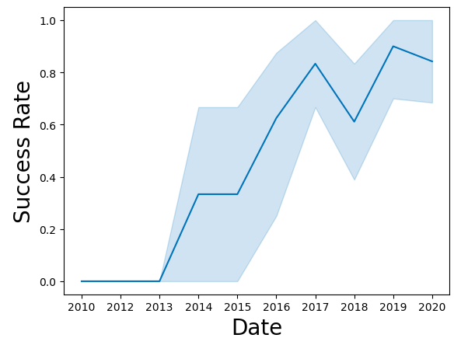
Launch Success Yearly Trend
Since 2013, success has increased, but in 2018, there is a decrease in launch success. Following 2018, there are attempts to increase the success rate, but it does not return to the level of success seen in 2017

Slide 24
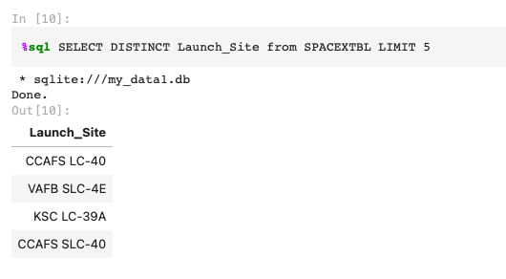
All Launch Site Names

Slide 25
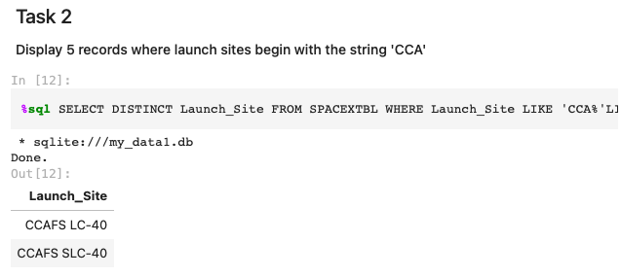
Launch Site Names Begin with 'CCA'

Slide 26
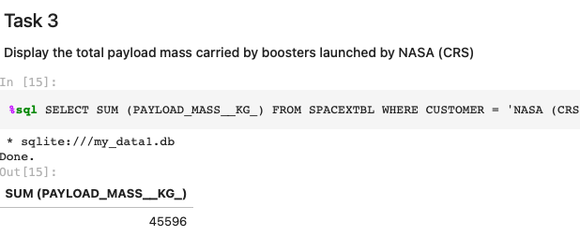
Total Payload Mass

Slide 27
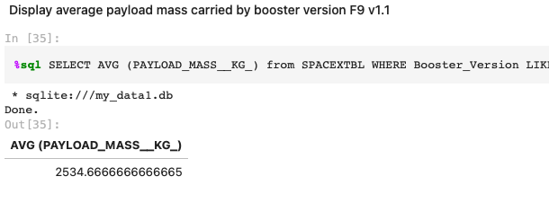
Average Payload Mass by F9 v1.1
Calculate the average payload mass carried by booster version F9 v1.1

Slide 28
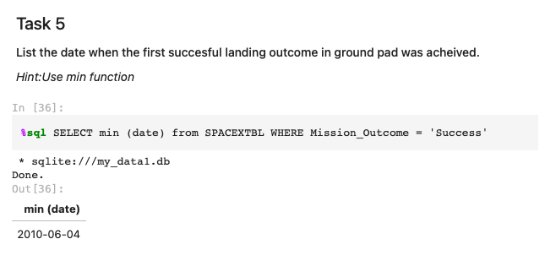
First Successful Ground Landing Date

Slide 29
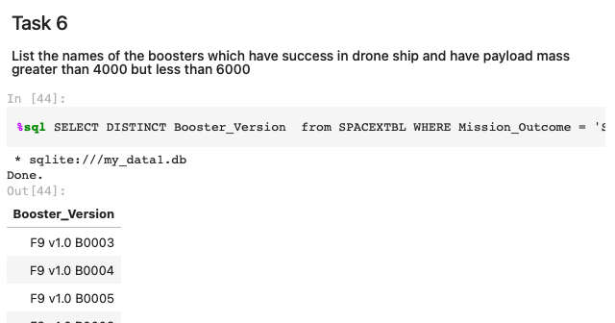
Successful Drone Ship Landing with Payload between 4000 and 6000

Slide 30
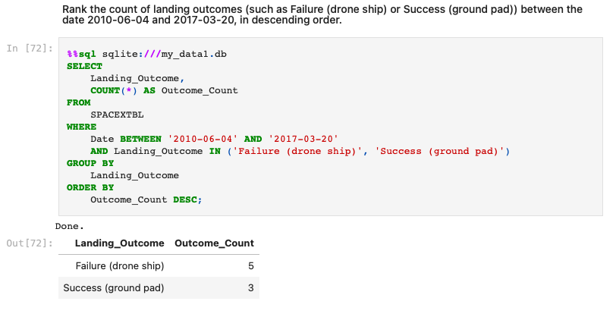
Total Number of Successful and Failure Mission Outcomes

Slide 31
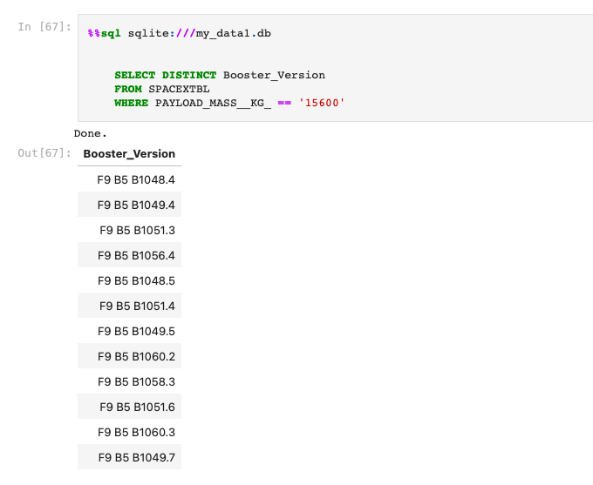
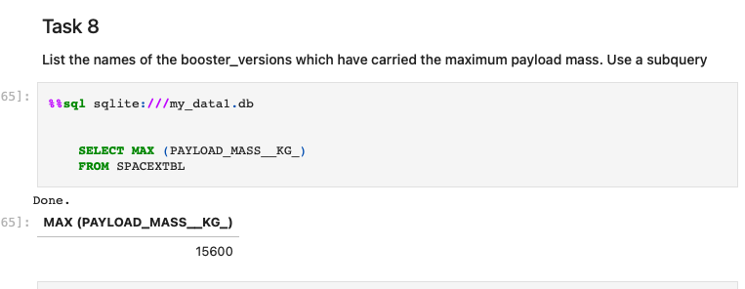
Boosters Carried Maximum Payload

Slide 32
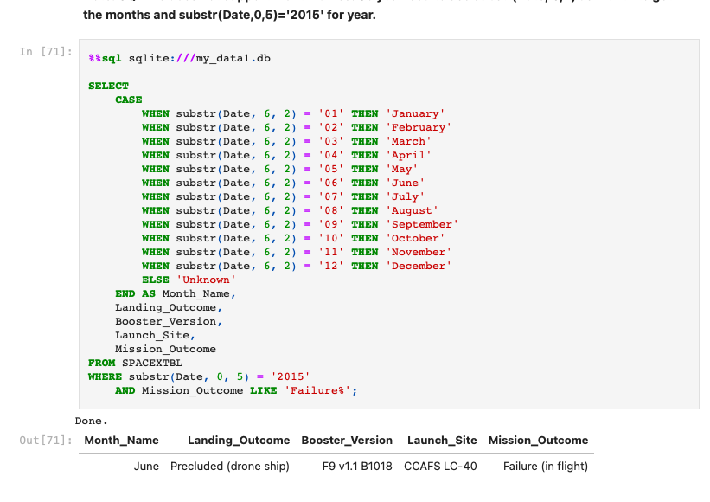
2015 Launch Records

Slide 33
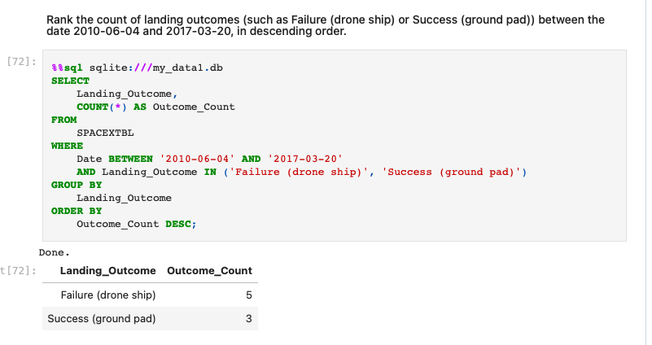
Rank Landing Outcomes Between 2010-06-04 and 2017-03-20
Rank the count of landing outcomes (such as Failure (drone ship) or Success (ground pad)) between the date 2010-06-04 and 2017-03-20, in descending order

Slide 34

Section 3

Slide 35
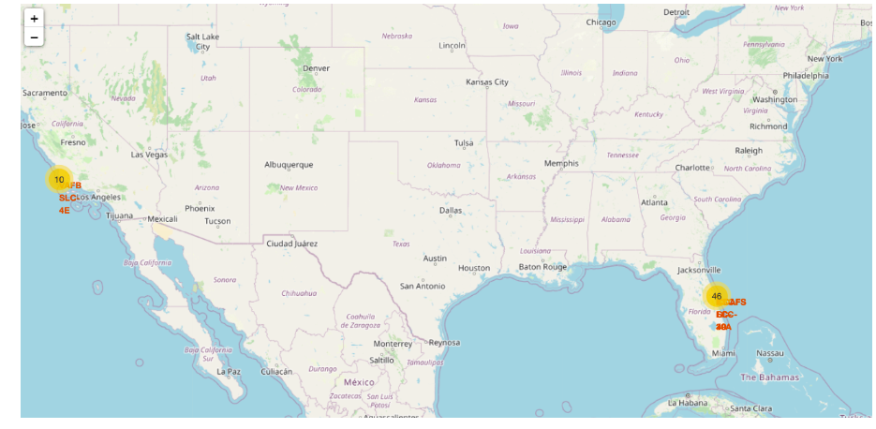
LAUNCH RECORDS
Note that a launch only happens in one of the four launch sites, which means many launch records will have the exact same coordinate. Marker clusters can be a good way to simplify a map containing many markers having the same coordinate.

Slide 36
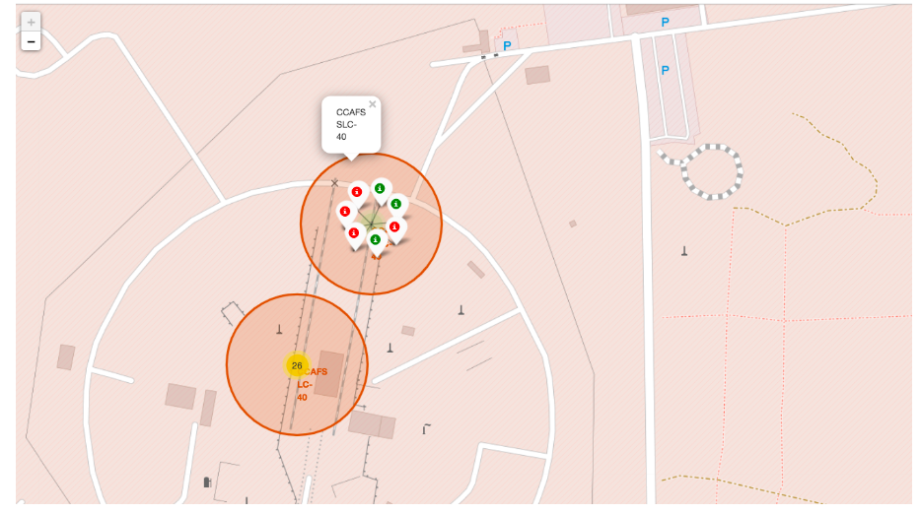
LABELED LAUNCHES OUTCOMES
Explore the folium map and make a proper screenshot to show the color-labeled launch outcomes on the map

Slide 37
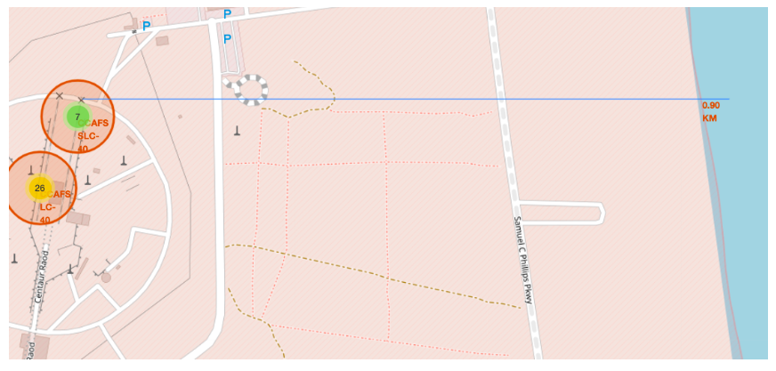
Proximities: railway, highway, coastline
Close to railway.

Slide 38

Section 4

Slide 39
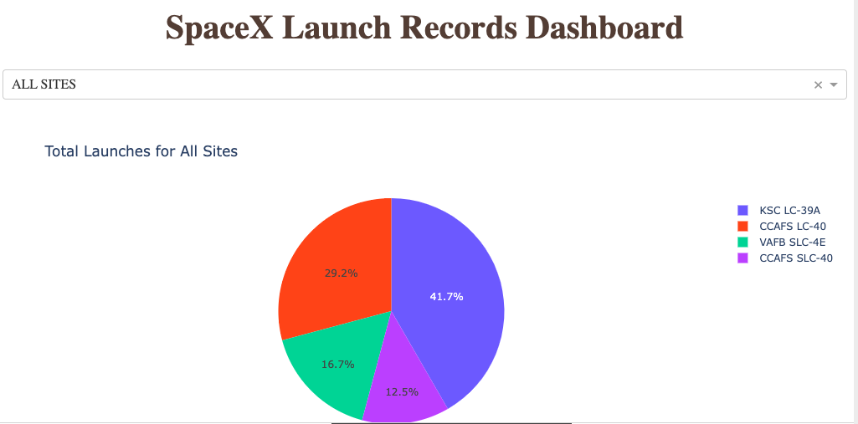
SpaceX Launch Records Dashboard

Slide 40
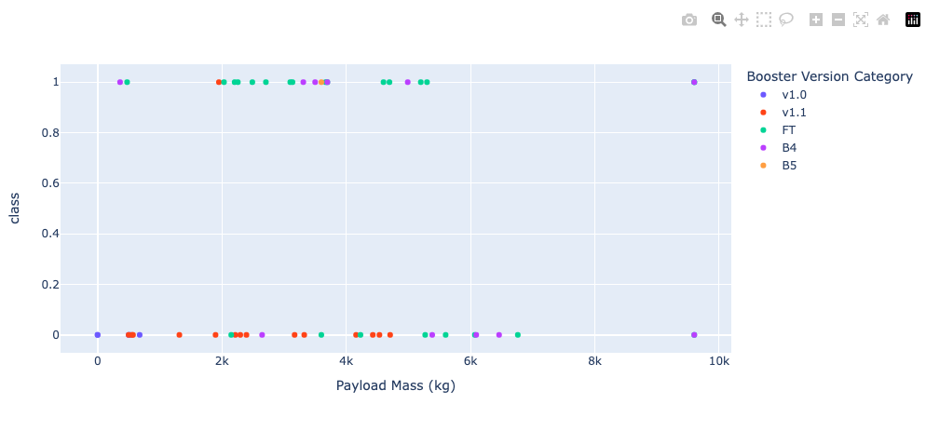
SpaceX Launch Records Dashboard

Slide 41

Section 5

Slide 42
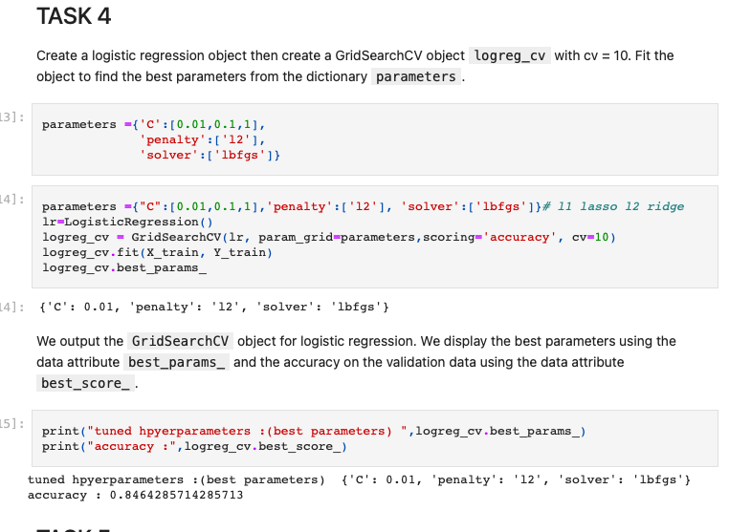
Classification Accuracy

Slide 43
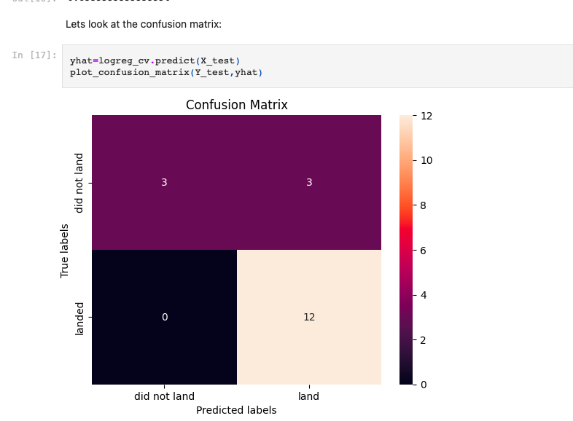
Confusion Matrix
High precision, except for false positives.

Slide 44
Conclusions
Different algorithms were used, such as logistic regression, support vector machine, decision tree, and KNN. The precision among all the methods was similar.
However, in this case, I would choose logistic regression as the best method because one of the most important aspects of the initial model selection is how easily it can be interpreted and put into production for testing on real data.

Slide 45


